Slide 1
Project Scope
WebDocs is a Web Application which provides several services to the Doctors. The main purpose behind this application is to manage doctor’s appointments & allows patients to book an appointment from the comfort of their homes, using their computer, laptop or mobile, and at any time.

Slide 2
No formal knowledge is needed for the user to use this application. Thus by this it proves it is user-friendly application. WebDocs application, as described above, can lead to error free, secure, reliable and fast management system.

Slide 3
WebDocs web application is having following features :
1.Login/Registration
2.Appointment Management
3.Feedback/Rating Management

Slide 4
Development Tools details :
Tool | Version | Use
Spring tool suite 4 | 4.13.0.RELEASE | Backend
VS Code Editor | 1.60.0 | Front end
MySql | 8.0.27 | Database
PostMan | Postman v8.8.0 | Rest API test
Web browser(chrome) | Version 92.0.4515.159 (Official Build) (64-bit) | UI Testing
Git | git version 2.31.1.windows.1 | Version control

Slide 5
Development Technologies :
Technology | Version | Use
Java | java version "1.8.0_291" | Development ( Controller , Model )
HTML | HTML5 | View Pages
CSS | CSS3 | Style sheets
Java_Script | v14.17.1 | DOM manipulation , Dynamic Response
BootStrap | Bootstrap v5.1.0 | Resposiveness to Device
React-Js | 17.0.2 | Dynamic SPA
SpringBoot | 2.5.4 | Backend Framework
Hibernate | 5.4.21.Final | ORM tool

Slide 6
1st Module : Doctor and Patient Registration
Doctor's Registration:
1.Doctor's Registration form
2. Document uplaod
3. Clinic Information
4. Submission
5. Aprroval by Admin
6. Registration Successfull
Patient's Registration:
1.Patient's Registration form
2. Health Information
3. Submission
4. Registration Successfull

Slide 7
2nd Module : Appointment Management
1. Patient Login
2. Search Doctor by Specialization / Location
3. View Doctor Profile
4. Book Appointment
5.View Appointment Status / Reschedule Appointment
6.Logout

Slide 8
Reminder to both by System :
1.Doctor Login
2.Update Slots
3. View Appointments
4. Confirm / Cancel / Reschedule Appointment
5. After Appointment , Upload Written Presciption on Patient Request
6.Logout

Slide 9
4th Module : Feedback / Rating management
1.Admin login
2.view Feedback
3. Update Ratings wise feedback on Doctor's Profile
4.Logout

Slide 10
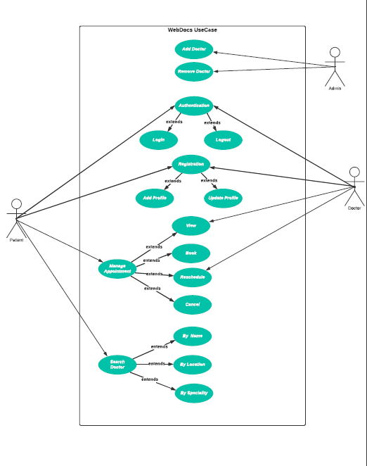

Slide 11
WebDocs-Project-DBSchema :
Primary Key | Foreign Key
Red | Green
Patient
Patient_Id | Patient_Name | Patient_Photo | Patient_DOB | Patient_Gender | Patient_Mobile_number | Patient_Email | Patient_Username | Patient_Password
int auto_increment | varchar(500) | longblob | date | varchar(500) | varchar(500) | varchar(500) | varchar(500) | varchar(500)
Doctor
Doctor_Id | Doctor_Name | Doctor_Photo | Doctor_DOB | Doctor_Gender | Doctor_Mobile_number | Doctor_Email | Doctor_License_Number | Doctor_Category_Id | Doctor_Hospital_Id | Doctor_Experience | Doctor_Fees | Doctor_Username | Doctor_Password
int auto_increment | varchar(500) | longblob | date | varchar(500) | varchar(500) | varchar(500) | varchar(500) | int | int | int | int | varchar(500) | varchar(500)
Category
Category_Id | Specialization | Description
int auto_increment | varchar(500) | varchar(500)
Hospital
Hospital_Id | Hospital_Name | Hospital_Address | Hospital_Image
int auto_increment | varchar(500) | varchar(500) | longblob
Slot
slot_id | Slot_Doctor_id | Slot_Hospital_id | Slot_Date | Slot_Start_Time | Slot_End_Time
int auto_increment | int | int | date | time | time
Appointment
Appointment_id | Appointment_slot_id | Appointment_Doctor_id | Appointment_Patient_id | Appointment_Status
int auto_increment | int | int | int | boolean
Feedback
Feedback_Id | Feedback_Patient_Id | Feedback_Doctor_Id | Feedback_Text | Feedback_Rating
int auto_increment | int | int | varchar(1000) | int CHECK(between 1 to 5)

Slide 12

Index page :

Slide 13
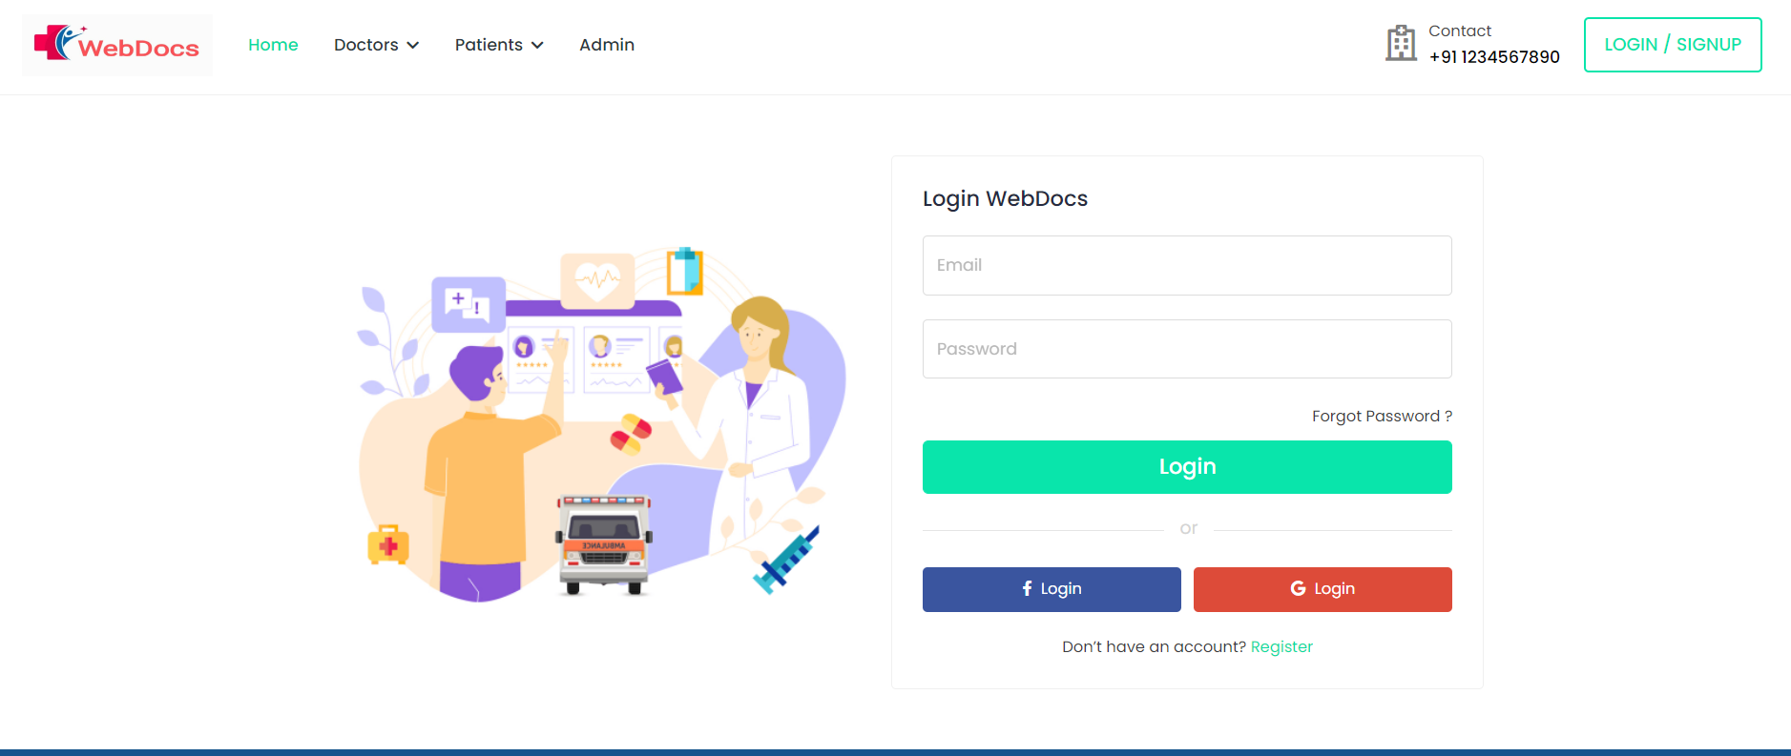
Login page :

Slide 14
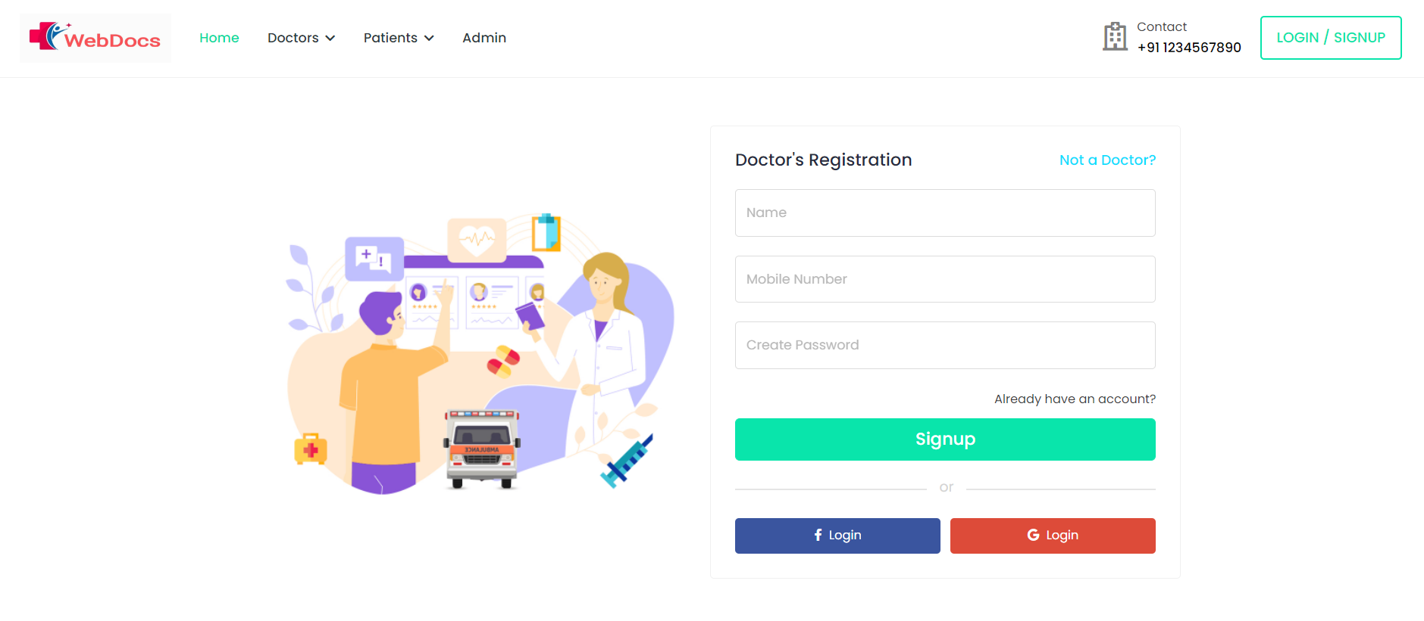
Registration page :

Slide 15
Section | Team
Front End | Rushikesh Kawale | Vaibhav Kulthe
Backend | Ashutosh Yadav | Divya Hinge
Database | Prajakta Chavan | Dnyaneshwar Mirkute

Slide 16
Thank you!!

